Slide 1
Learning with Large Datasets

Slide 2
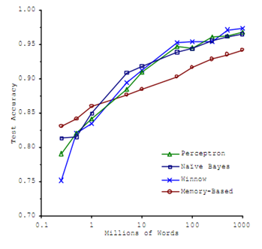
Machine learning and data
Classify between confusable words.
E.g., {to, two, too}, {then, than}.
For breakfast I ate _____ eggs.
Accuracy
Training set size (millions)
“It’s not who has the best algorithm that wins.
It’s who has the most data.”
[Figure from Banko and Brill, 2001]

Slide 3
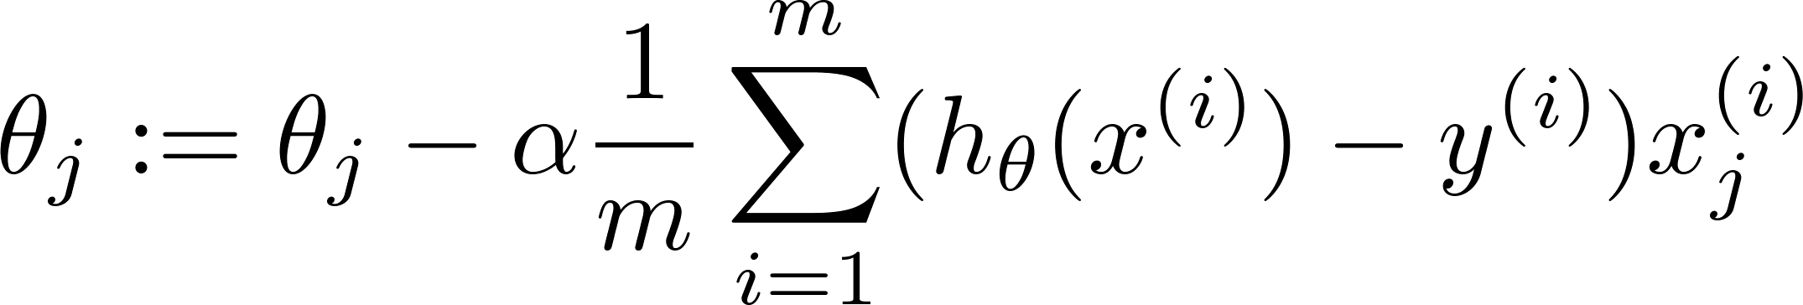
Learning with large datasets
Adding extra features, hidden unit in neural networks, .. (say) and then increasing m
Increasing m will not give us any gain
error
error
(training set size)
(training set size)
m = 1000

Slide 4
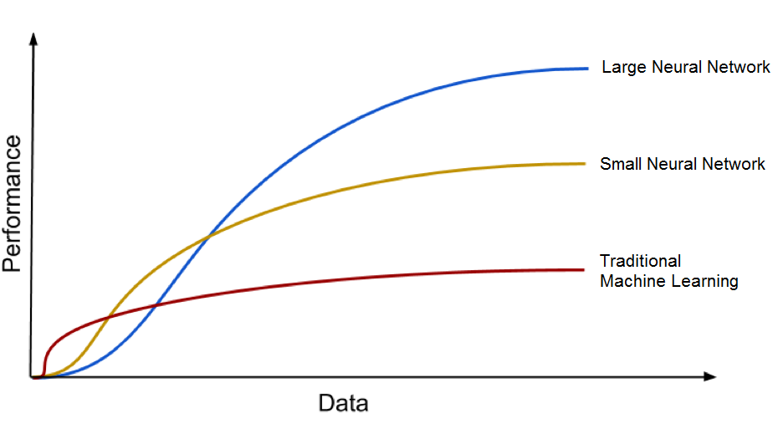

Slide 5
Stochastic Gradient Descent

Slide 6
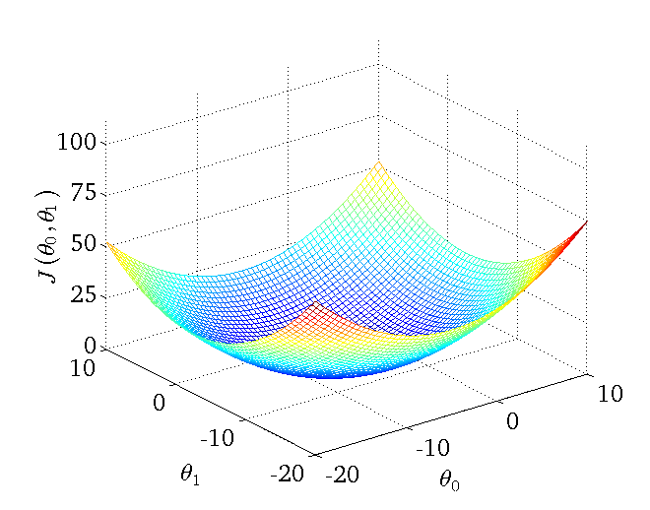
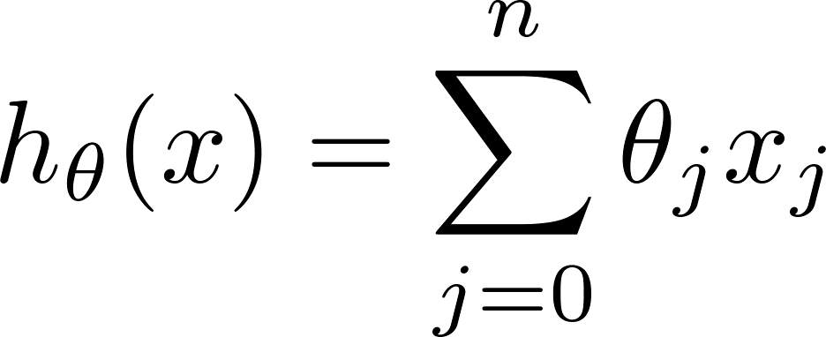
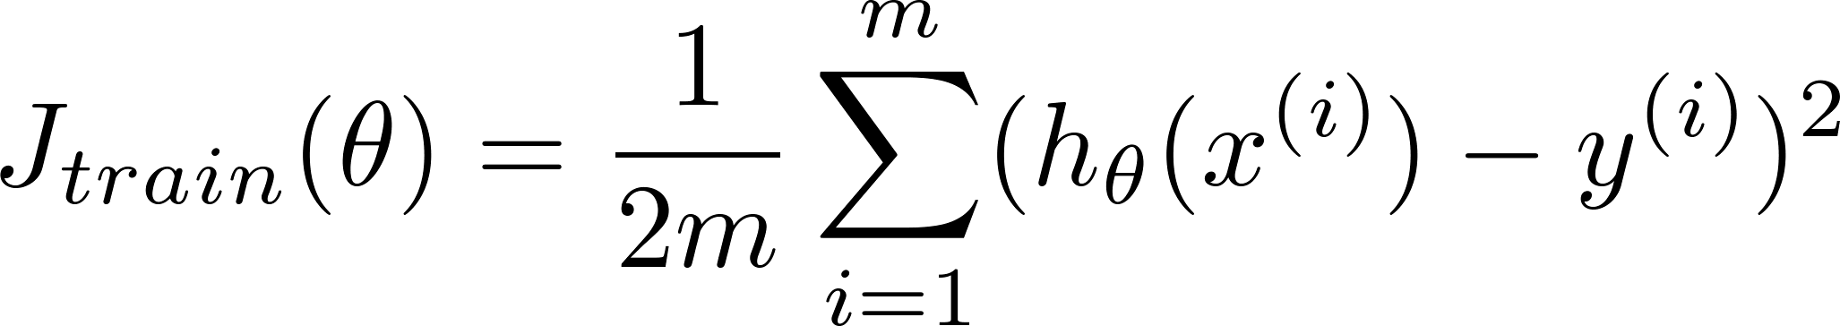
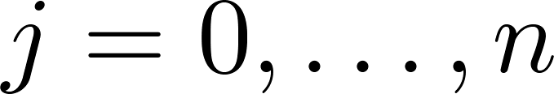
Linear regression with gradient descent
Repeat {
(for every )
}
Notes:
Add dots

Slide 7
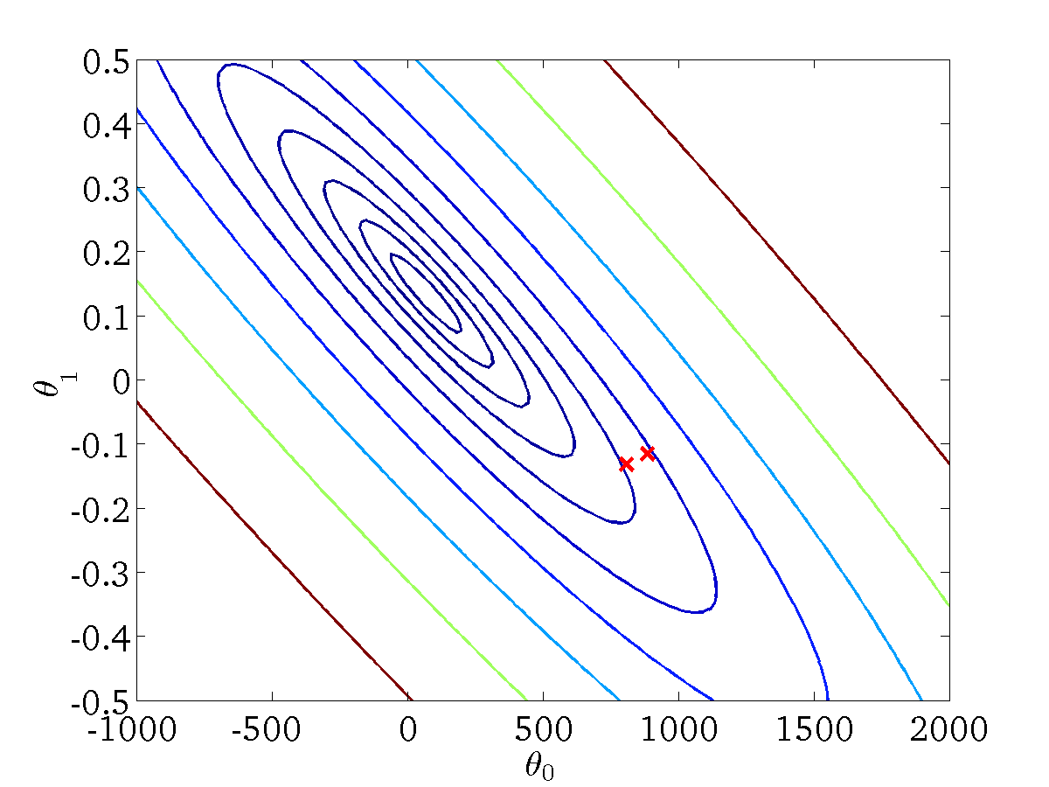
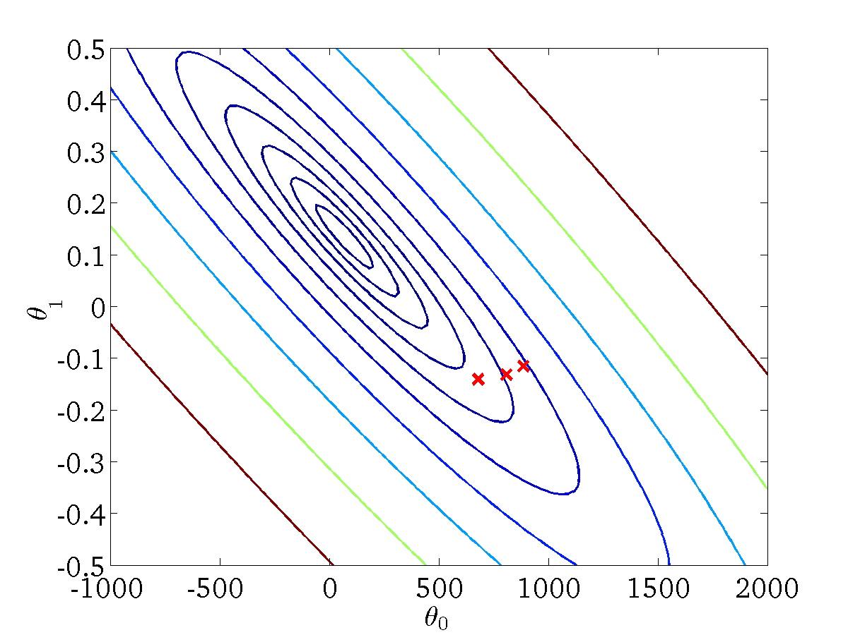

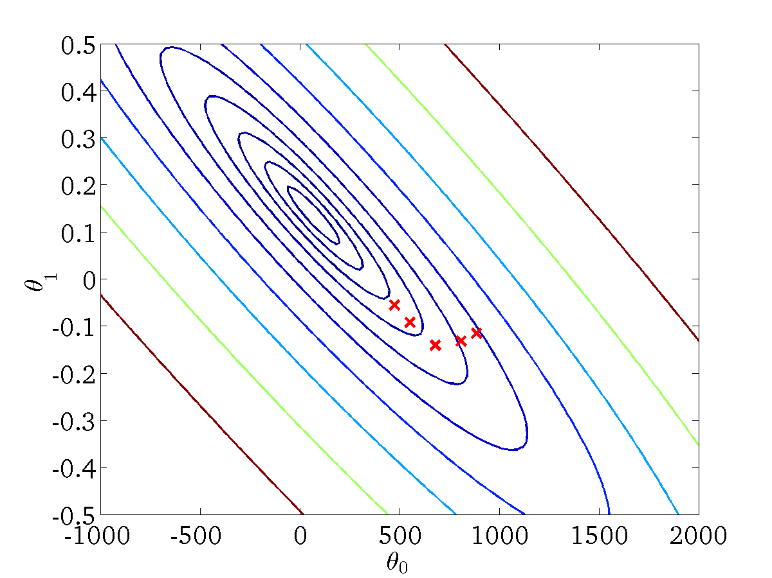


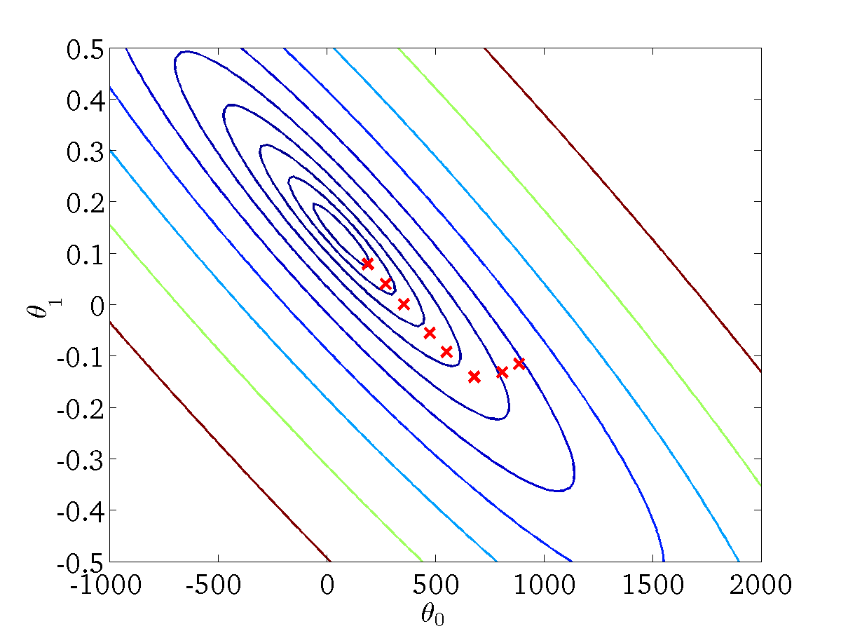


Linear regression with gradient descent
Repeat {
(for every )
}
When m is large then computing the
derivative becomes very difficult

Slide 8
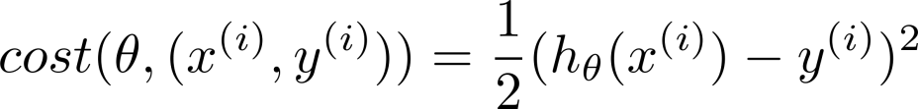
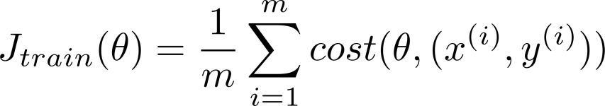
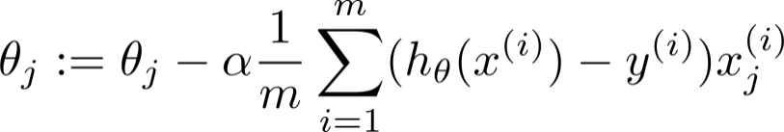
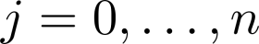
Batch gradient descent
Stochastic gradient descent
Repeat {
(for every )
}
(Pre-processing step)
step 1: we modify parameters and try to fit 1st training example.
step 1: we modify parameters and try to fit 2nd training example.
So on

Slide 9
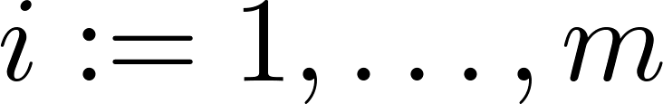
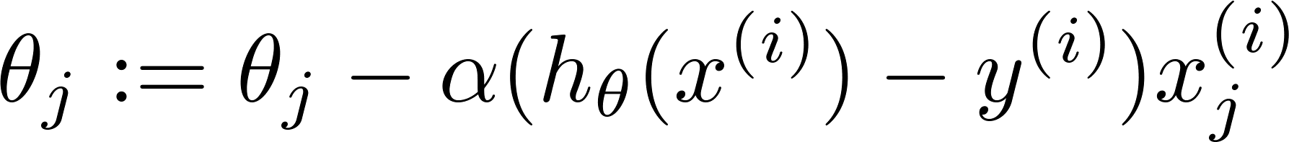
Stochastic gradient descent
Randomly shuffle (reorder) training examples
Repeat {
for {
(for every )
}
}
How much to repeat the for loop ?
Generally depends on the size of the training set but normally 1-10 repetition works fine

Slide 10
Mini-batch Gradient Descent

Slide 11
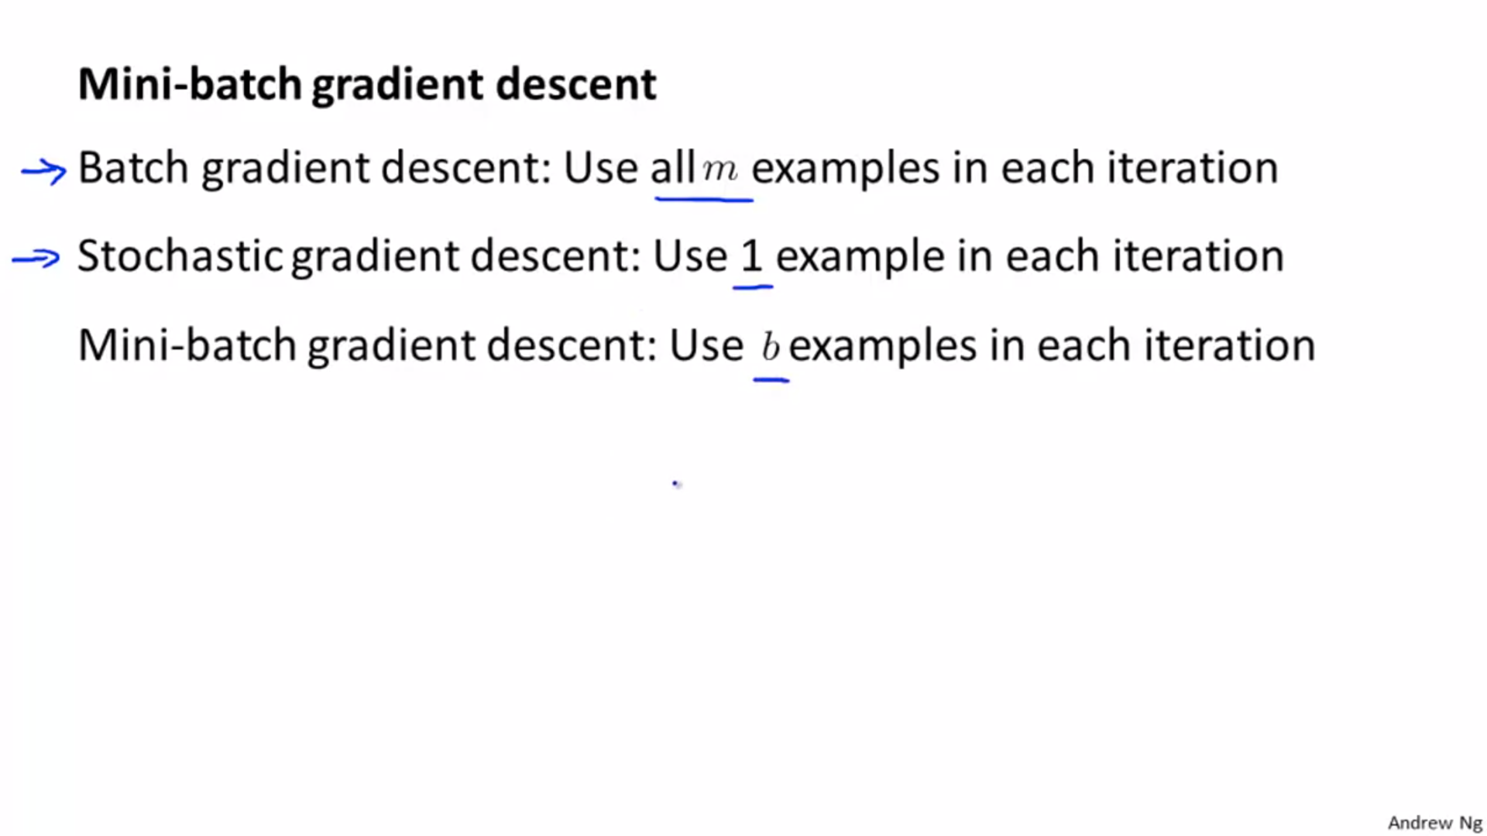

Slide 12
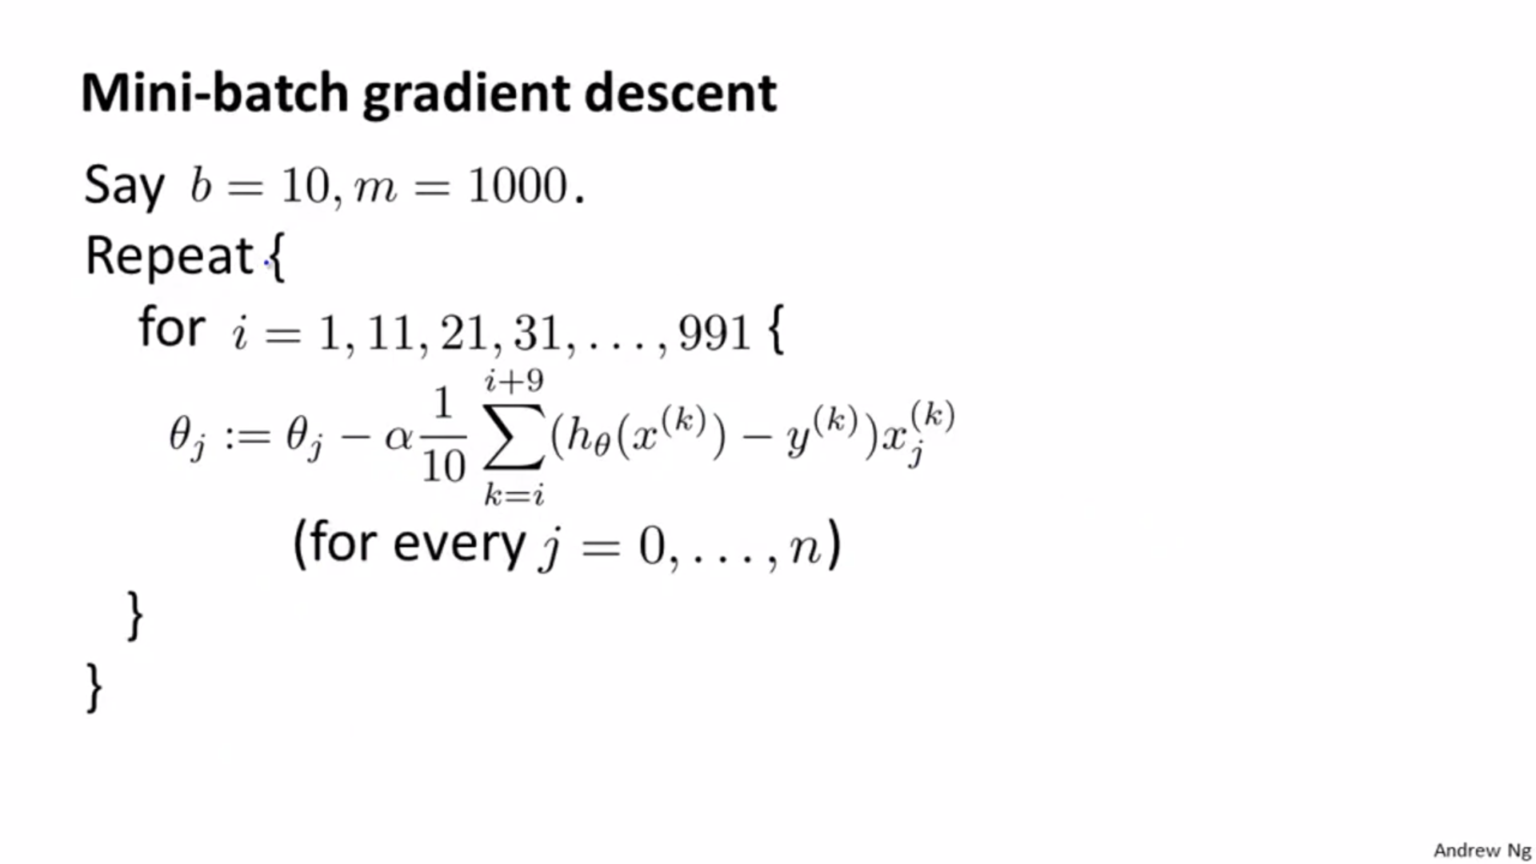

Slide 13
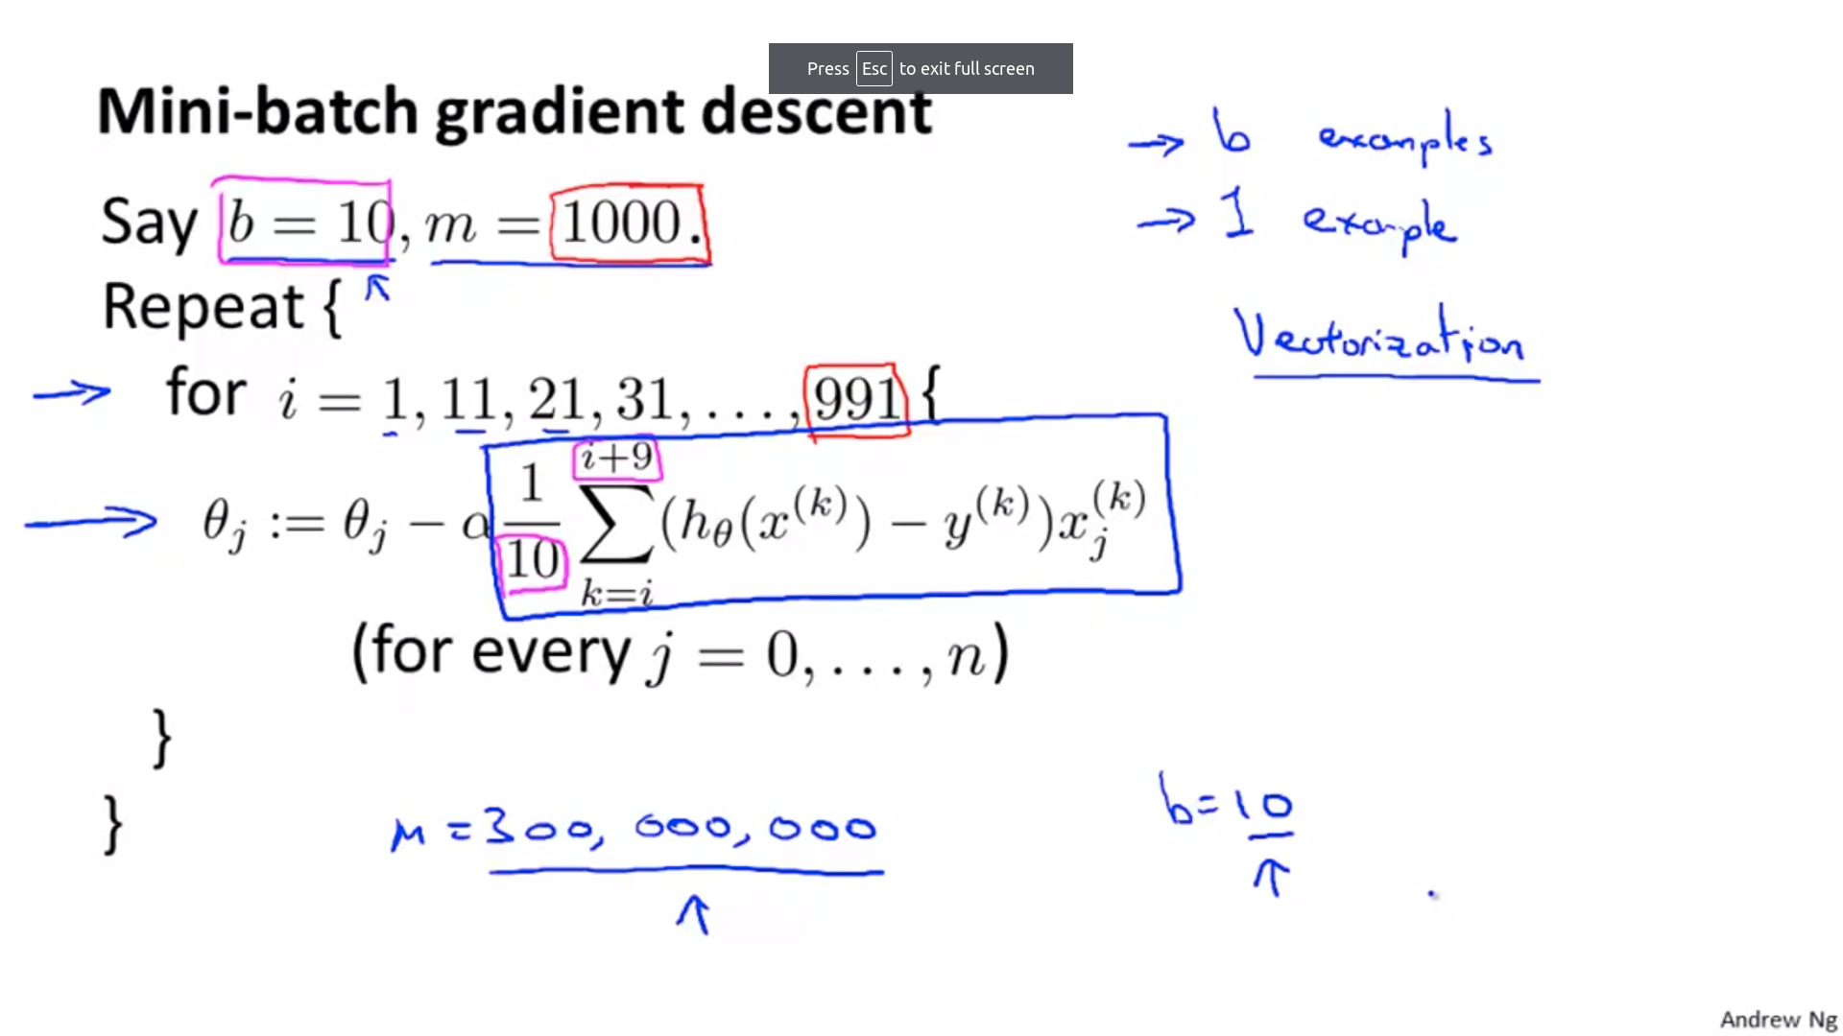

Slide 14
Stochastic Gradient Descent Convergence

Slide 15
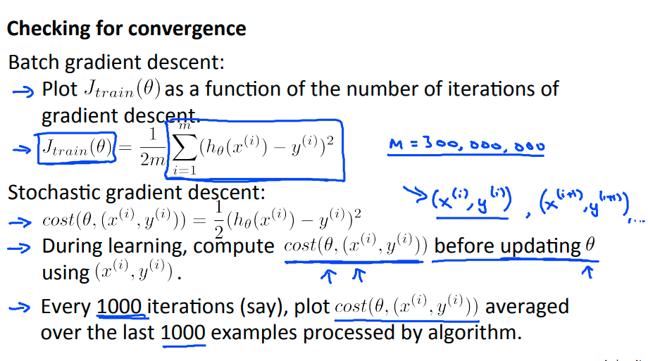

Slide 16
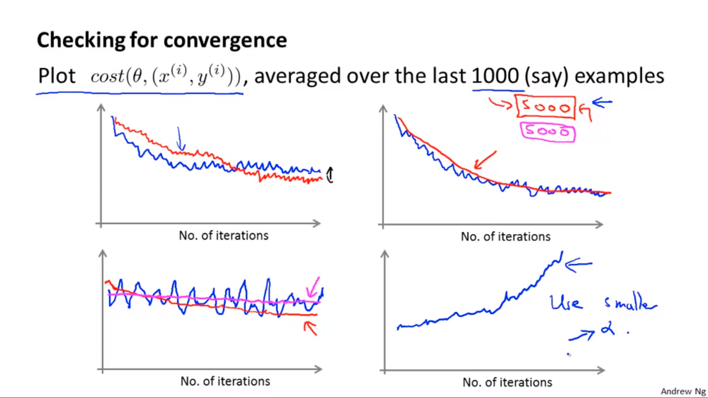

Slide 17
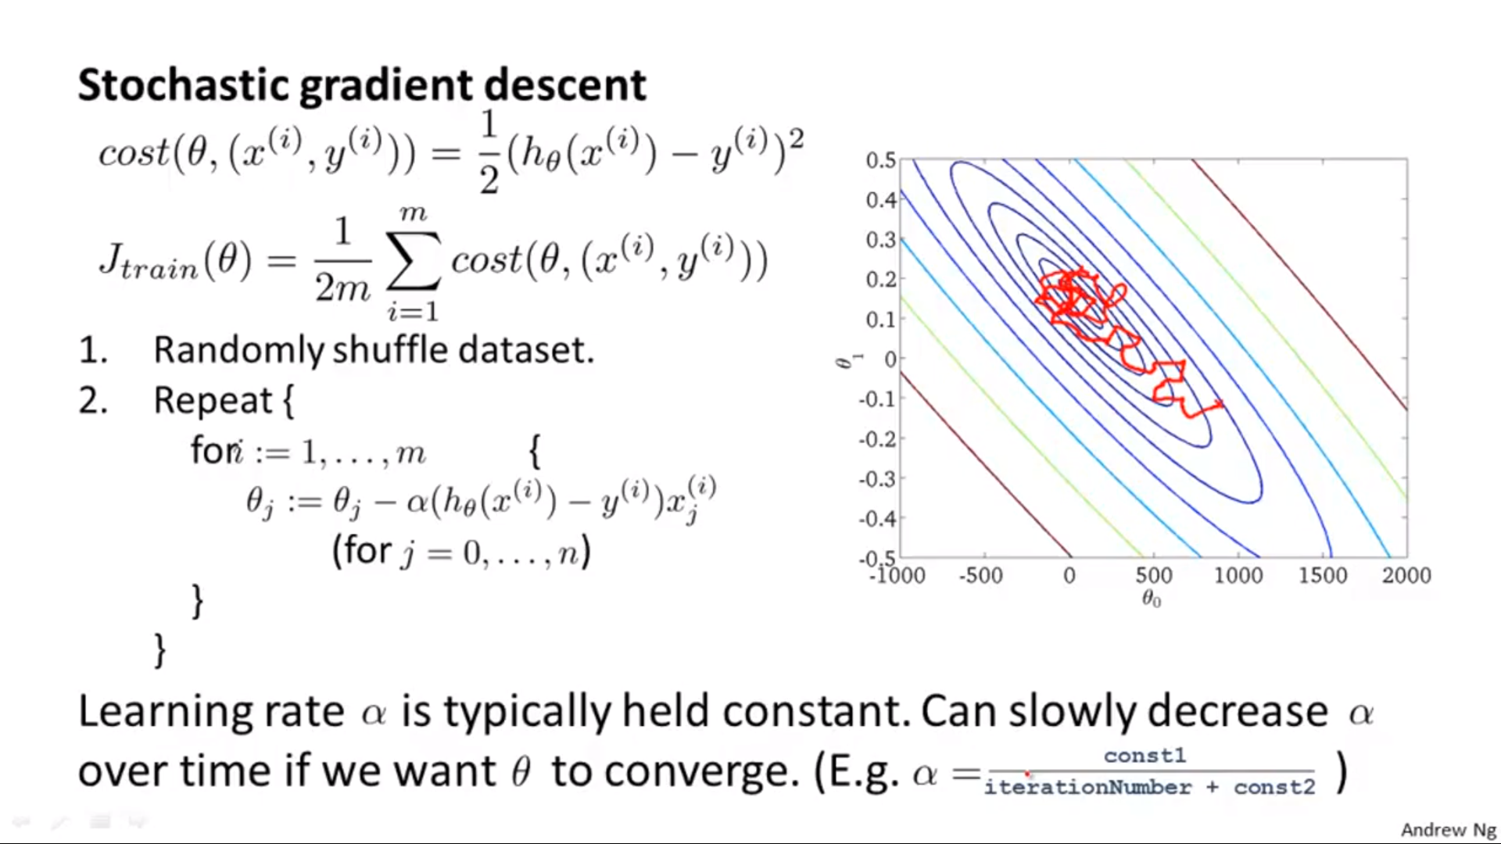

Slide 18
Online Learning

Slide 19
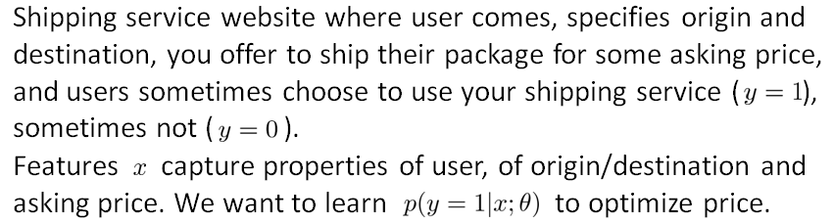
Online Learning

Slide 20
Online Learning
Repeat forever {
Get (x, y) corresponding to user
Update θ using (x, y):
θ_{i} = θ_{i} – α(h(x) - y).x_{i} (i= 0, 1, …n)
}

Slide 21
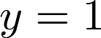
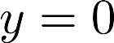
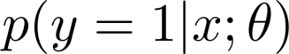
Other online learning example:
Product search (learning to search)
User searches for “Android phone 1080p camera”
Have 100 phones in store. Will return 10 results.
features of phone, how many words in user query match name of phone, how many words in query match description of phone, etc.
if user clicks on link. otherwise.
Learn .
Use to show user the 10 phones they’re most likely to click on.
Other examples: Choosing special offers to show user; customized selection of news articles; product recommendation; …
Notes:
Make points have 0 mean on x1 and x2

Slide 22
Map Reduce And Data Parallelism

Slide 23

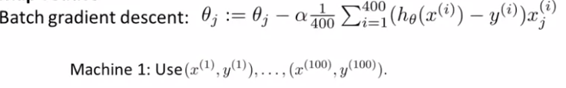
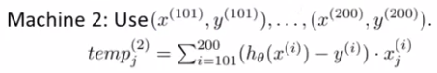
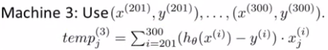
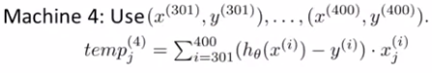
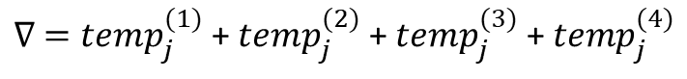
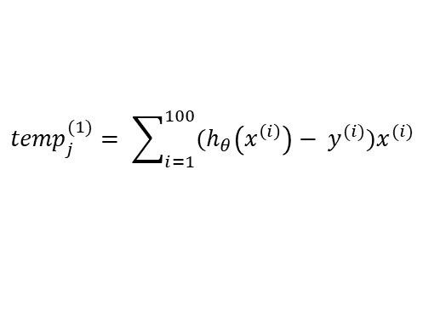
Map reduce
$${temp}_{j}^{(1)}= \sum_{i=1}^{100}{(h_{θ}\left(x^{\left(i\right)}\right)− y^{(i)})x^{(i)}}$$
$∇ ={temp}_{j}^{(1)}$ + ${temp}_{j}^{(2)}$ + ${temp}_{j}^{(3)}$ + ${temp}_{j}^{(4)}$

Slide 24
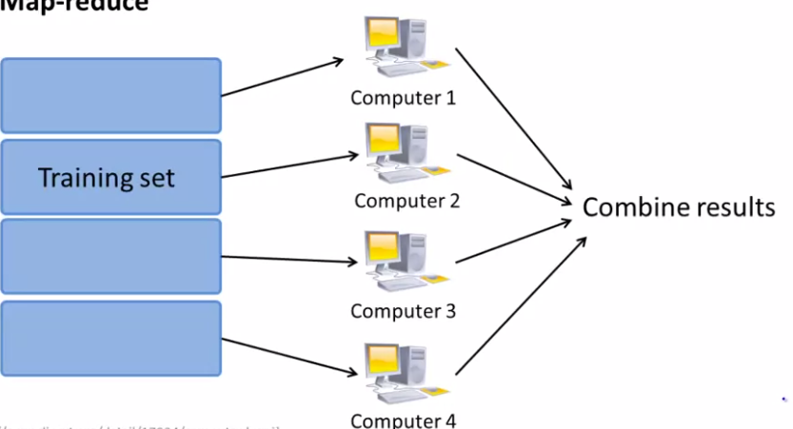
Map Reduce

Slide 25
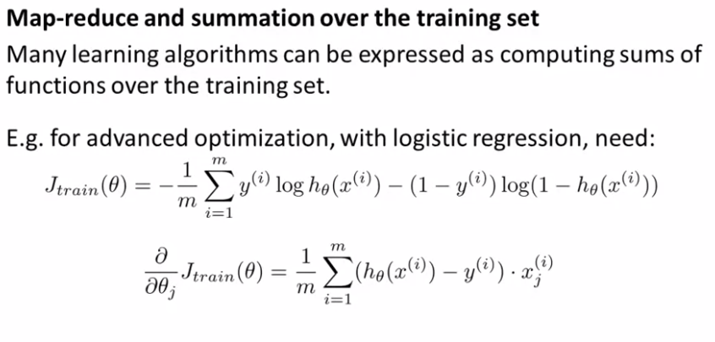
Map Reduce

Slide 26
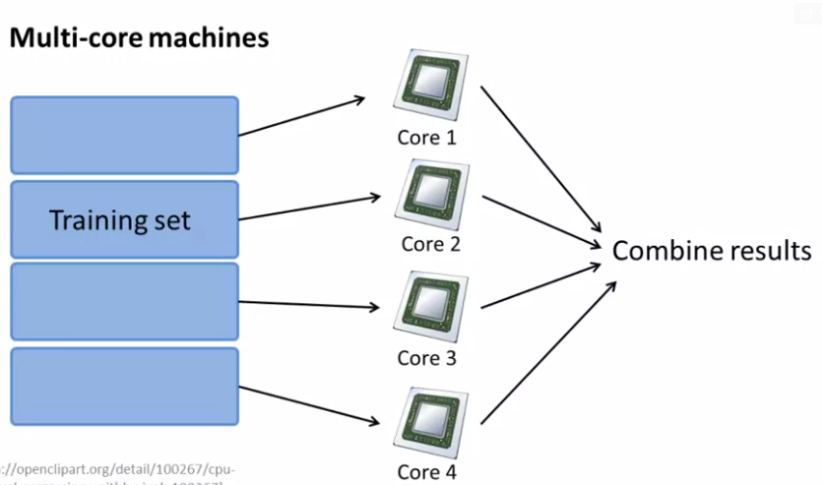

Map Reduce

